Slide 1


Airline Safety Today
Evan Edmunds

Slide 2
Current Concerns
Safety
Crashes
Where we stand now

Slide 3
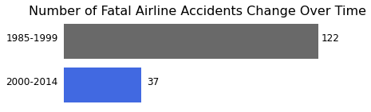
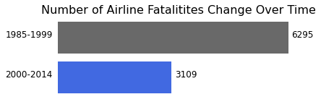
Then and Now
Airline safety has improved over the years
Number of fatalities have decreased
Number of fatal crashes have decreased

Slide 4
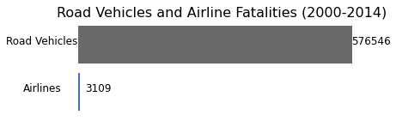
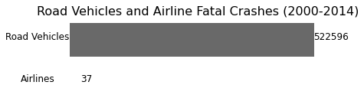
Still the Safest Way to Travel?
Compared to Road Vehicles, airlines have lower fatal accidents
They also have lower fatalities as well

Slide 5
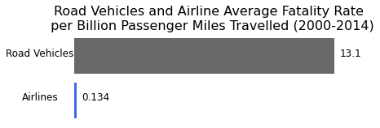
A Fairer Comparison
When put on the same scale, airlines are still a much safer bet
Mile for mile, you’re safer in the sky

Slide 6

30 Years of Excellence
12 out of the 56 airlines we examined had no fatalities bytween 1985-2014.

Slide 7
Sources
Aviation Safety Network: https://github.com/fivethirtyeight/data/tree/master/airline-safety
NHTSA: https://www-fars.nhtsa.dot.gov/Trends/TrendsGeneral.aspx
Github Repository: https://github.com/tripleee19/AirlineSafety

Slide 8
Thank You
We’re committed to safety
We’re committed to you

